Slide 1
Machine learning
Presented by
Prof. Pushkar Sathe

Slide 2
Machine learning (ML)
Subset of Artificial Intelligence (AI)
Works in a similar way to human learning
Ability of system to independently find solution
Ability to automatically learn and improve from experience
No explicit instructions used
Builds a mathematical model based on sample data (training data)

Slide 3
ML applications
Virtual Personal Assistants e.g. Alexa
Face recognition on Facebook
Video recommendation of YouTube
Google translator
Spam detection on Gmail
Medical field : diagnosis and prognosis
Sentiment analysis

Slide 4
ML algorithm types
Supervised learning
Unsupervised learning
Reinforcement learning

Slide 5
Supervised learning algorithms
Simple linear regression
Multiple linear regression
Logistic regression
Support Vector Machine
Decision tree
Random forest
Naïve Bayes

Slide 6
Simple linear regression
Statistical method used for regression
Study of relationship between independent and dependent variables
Involves one dependent variable and one independent variable
Both the variables are continuous in nature
Model is ‘best fitting line’

Slide 7
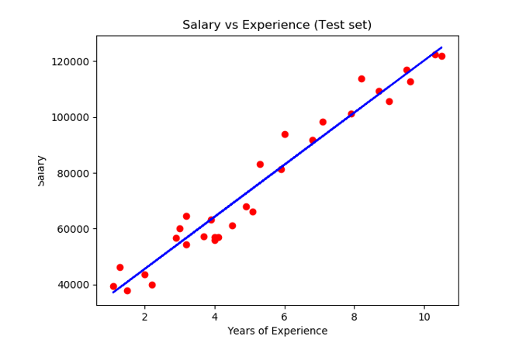
Example

Slide 8
Best fit line
y = m.x + c
Line belonging to optimum values of ‘m’ and ‘c’ is best fit line
Least square approach is used
Error = ( predicted value – actual value ) of dependent variable
Sum of squares of errors of all data points should be minimum

Slide 9
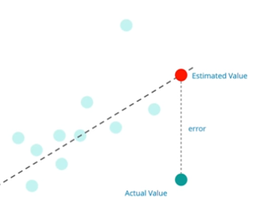
Error

Slide 10
Thank you
https://Medium.Com/@Camrongodbout/Recurrent-Neural-Networks-For-Beginners-Aca4e933b82
https://Medium.Com/@Camrongodbout/Recurrent-Neural-Networks-For-Beginners-Aca4e933b82

